Slide 1
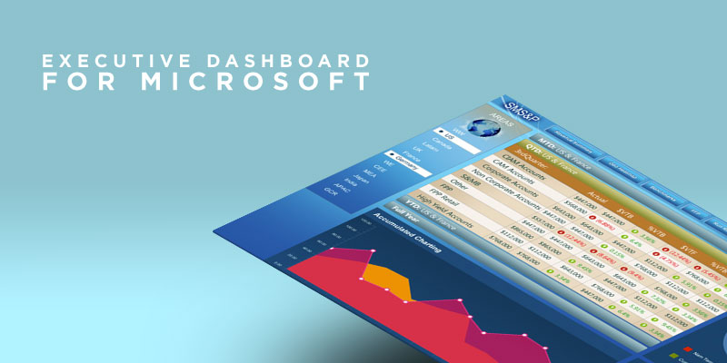
MS Executive Dashboard
The Challenge
Microsoft Small and Midmarket Solutions & Partners needed a way to create accountability while allowing all levels of the organization to make more insightful decisions with real-time and accurate information. SMS&P engaged with Affirma to create an intuitive, fast and rich analysis resource for Finance Executives.
What We Did
Affirma created a Silverlight-based interactive dashboard that configured all data access from multiple data sources. Geographic KPI interactivity allows Finance Executives to view key performance indicators in new and contextually relevant ways very quickly. Executives can drill data by metric, time and geography, even when offline. The dashboard's offline capabilities provide greater windows of time for analysis across the team.
Results
The executive dashboard was an overwhelming success. Scorecarding allows the organization to track what groups and individuals are performing to target. This creates a strong alignment of accountability that rolls up into the company's strategic objectives and goals. With access to real-time, accurate data from a single source, the business is now able to quickly release reporting and make stronger business decisions across all levels of the organization. End users love the SMS&P Executive Dashboard and it is currently being socialized around SMS&P Finance.

